Slide 1
Section 3.3 Part 2
Percentage of a Number:
© Copyright all rights reserved to Homework depot: www.BCMath.ca

Slide 2
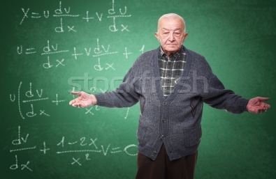
Suppose there’s an old teacher in your school but you don’t know exactly how old he is.
IF you are told that 50% of his age is 32. How old is this teacher?
So we know that:
At the same time:
So this means that
Mr. Old is 64 years old.
© Copyright all rights reserved to Homework depot: www.BCMath.ca

Slide 3
In this section, you will be given percentage of an unknown number and then asked to find the value of that unknown number
Ex: 30% of an unknown number is 15. What is the unknown number?
Suppose we have a box and the area is equal to the value
of this unknown number
Now, 30% of the area is equal to 15
Before we find the area of the whole
shape, find the area of one tiny box:
So the area of one tiny box is 0.5 units
Since there are 100 tiny boxes, the
area of the entire shape is:
© Copyright all rights reserved to Homework depot: www.BCMath.ca

Slide 4
Practice: 24% of a number is 15.72. What is the unknown number?
First find the area of one tiny
box, which is the value of 1%
Then find the area of the entire
box, which is the value of 100%
So 1% is equal to 0.655
Practice: James has some money in his wallet. Edward has $30 and is 40% of James amount. How much does James have?
1% of James money is:
Then find the value of all the James
money in his wallet:
So 1% of James money
is 75 cents
© Copyright all rights reserved to Homework depot: www.BCMath.ca

Slide 5
Another way to find a value given it’s percentage is by drawing a diagram to represent what’s given
Ex: John wants to buy a car. 40% of the car’s value is $28,000. How much is the total cost of the car?
The shaded red region is worth $28,000
Now we have 4 columns, so each column
is worth $7,000
If the whole box represents the total
cost of the car and each column is worth
$7,000, then how much would 10 columns
be worth?

Slide 6
Practice:
i) If 45% of a number is 99. What is the number?
Cut the shaded area in 9 groups
Each of these blks is equal to 11
There are 20 groups and
Each group is equal to 11
So the total is 20 times 11 = 220
ii) 75% of 120 is equal to 15% of an unknown number. of a number is 81. What is the number?

Slide 7
ii) 75% of 120 is equal to 15% of an unknown number. of a number is 81. What is the number?

Slide 8
Ex: Brian and his girlfriend went to a fancy restaurant for dinner. After he paid, he forgot how much the dinner was. The only thing he remember was that he gave a 15% tip of $8.25. How much did the dinner cost?
© Copyright all rights reserved to Homework depot: www.BCMath.ca

